Slide 1
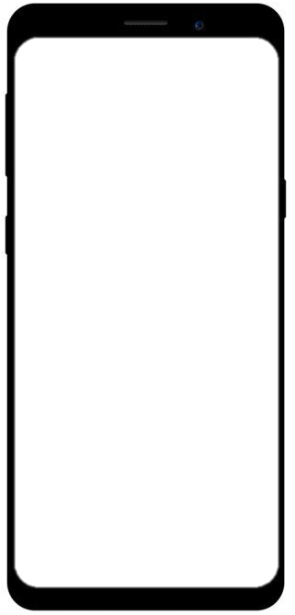
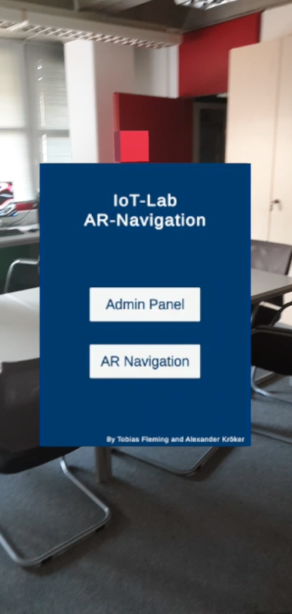
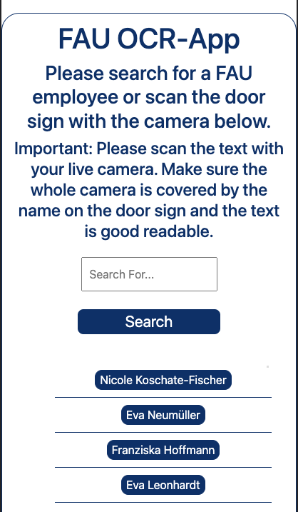
Practical Seminar / Hot Topics in Web Technologies and the Internet of Things
Developing a PWA with AR capabilities

Slide 2


Team
Tobias Fleming
6. Semester
Wirtschaftsinformatik
Alexander Kröker
6. Semester
Wirtschaftsinformatik

Slide 3

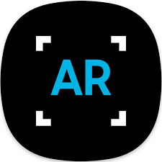
Agenda
OCR Application
Idea
Demonstration
Journey
Difficulties
IoT-Lab AR Application
Idea
Journey
Demonstration
Difficulties
Further development ideas
Conclusion

Slide 4
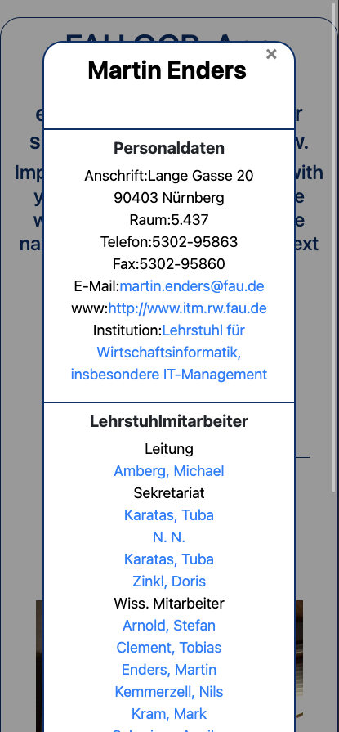
Everything starts with an Idea
OCR Application
Create an app that helps students find their way around the WiSo
How it works:
Students can scan a name tag that is in front of an office
When scanning the name, relevant data gets collected from univis
User gets displayed employee information like department name, lectures, and coworkers
Important for us:
Design easy to understand
Short loading times, high performance
Reliable character recognition

Slide 5
Target agreement
OCR Application
As a user, I would like to have all personnel data in UnivIS displayed in the app based on the WiSo employee's name, so I know exactly who they are.
As a user, I would like to retrieve additional chair information to the staff information so that I can better categorize the staff member. Chair information includes chair name, chair holder, other chair staff, and courses offered.
As a user, I would like to be able to retrieve a filterable list of all WiSo employees that I can use to select individual employees, so I don't have to type in the full name.
As a user, I should be able to use OCR to scan the names of office nameplates to directly retrieve UnivIS information.

Slide 6






Techstack
OCR Application
Languages, libraries, and frameworks
HTML, CSS, Javascript
Node.js, Express.js
Node-cron
Tesseract.js
Puppeteer.js
JsDoc
Heroku

Slide 7
How it works
OCR Application
Build a simple frontend
Simple and easy to use frontend to interact with
Camera with snapshot function
Build with HTML, CSS, and plain Javascript
2. Import Tesseract.js to progress snapshot content with OCR
Use the library to recognize the name that is scanned by the user
Calculate Levenshtein distance and show name with the lowest distance
3. Build a backend service
Send the OCR result to backend as JSON via HTTP request
Use Puppeteer.js to crawl UniVis for information and send the result back to the frontend
→ display information in frontend
Build with Node.js, Express.js

Slide 8

Demonstration
OCR Application

Slide 9
Journey & Difficulties: A lot of research and debugging
OCR Application
Topics:
Frontend-Backend communication
Work with asynchronous functions
Send, receive and handle HTTP requests
How to improve the circumstances for the OCR to better recognize characters
Performance of web crawlers
Deployment pipelines
Error handling on the web
Code documentation
Collaborative coding & versioning with GitHub

Slide 10
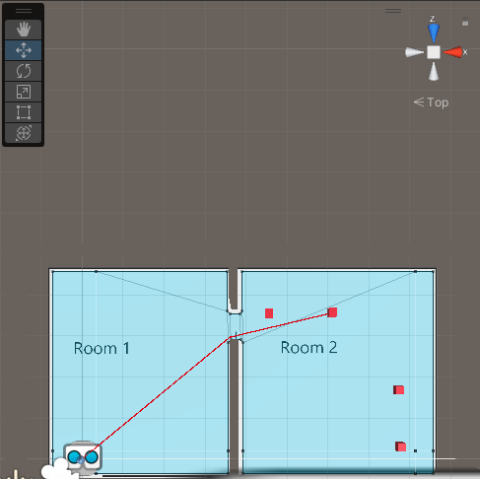
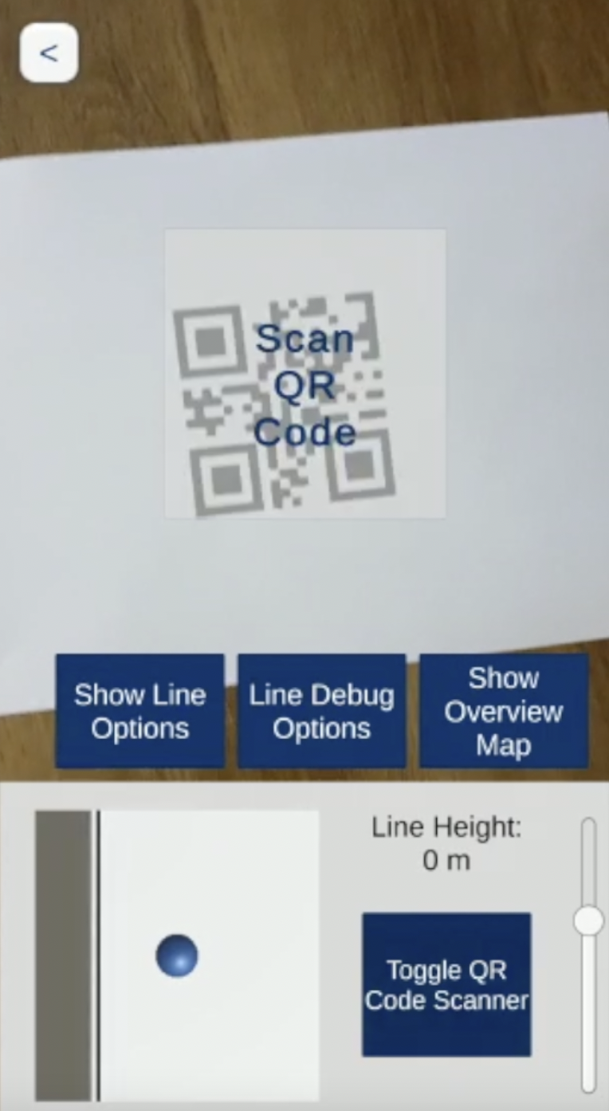
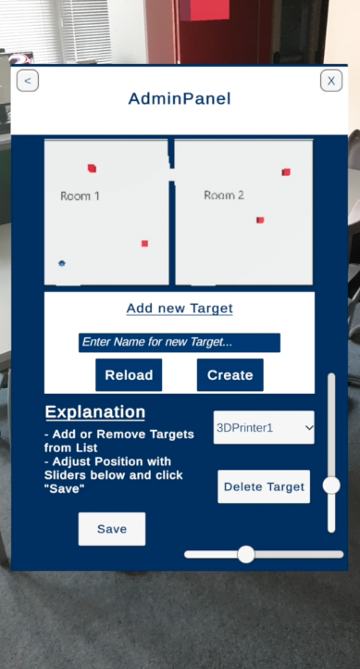
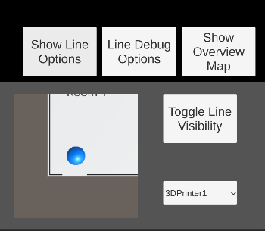
Practical Seminar / Hot Topics in Web Technologies and the Internet of Things
IoT-Lab-AR Application

Slide 11
Idea
IoT-Lab AR Application
Creating an App to help students find materials or devices in the IoT- Lab more easily
Our idea:
Creating an application with a live navigation option towards targets
Interactive and adjustable environment
Overview over the IoT-Lab
QR Scanner to get device information live on your smartphone
Important for us:
Design easy to understand and to use
Real-time data transfer
Short loading times, high performance

Slide 12
Target agreement
IoT-Lab AR Application
As a user, I would like a list and overview map of all the major devices and areas of the IoT Lab, so I can find my way around as a newbie.
As a user, I want the PWA to navigate or point me in the direction of the selected device/area using AR and using 2d map or 3d world.
As the person responsible for the lab, I would like to be able to move existing devices/areas in terms of location and description so that I can react if the structure of the lab changes.
With an QR Code Scanner, I want to scan a QR Code to reset my position to the start position inside the application.

Slide 13

Journey
IoT-Lab AR Application
Libraries and frameworks
Unitiy
Unity AR Foundation
Docker
NodeJS
DocFX
Short Overview
Creating the environment and Camera Management
AR Navigation
First User Interface
Saving and loading target data via JSON
Implementing QR Scanner
Admin Panel with Password protection
Designing a new User Interface
Last changes due to incompatibilities
Web-based JSON file
Containerized REST-API with Docker

Slide 14
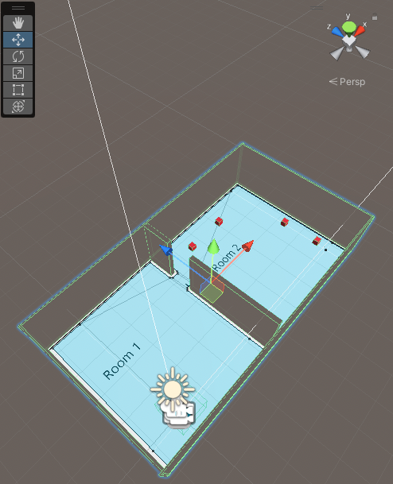
Journey
IoT-Lab AR Application
Creating the environment and Camera Management
One length unit in Unity is one Meter
Measure the room and recreate it in Unity
JPG file to give the floor a texture
Navigation Mesh for navigation area
Player as a blue ball followed by a camera
Red squares for the targets
AR Navigation
Creating a Script for continuously calculating the distance between two items and create a line between them
Line only shown when target selected or enabled via future button

Slide 15
Journey
IoT-Lab AR Application
First User Interface
Simple dropdown menu to select a target
Overview Map to show location in the map
Button for toggling the Line
→ Navigation functionality was working
Saving and Loading Target Data
Creating a JSON file for storing target data
Reading and Writing data to JSON via JSON-Utility class by Unity
Target Wrapper class as an array for storing all targets in environment and to be compatible with JSON-Utility
Target class with Name and position for every target
Target Facade class for managing the prefab of the targets

Slide 16
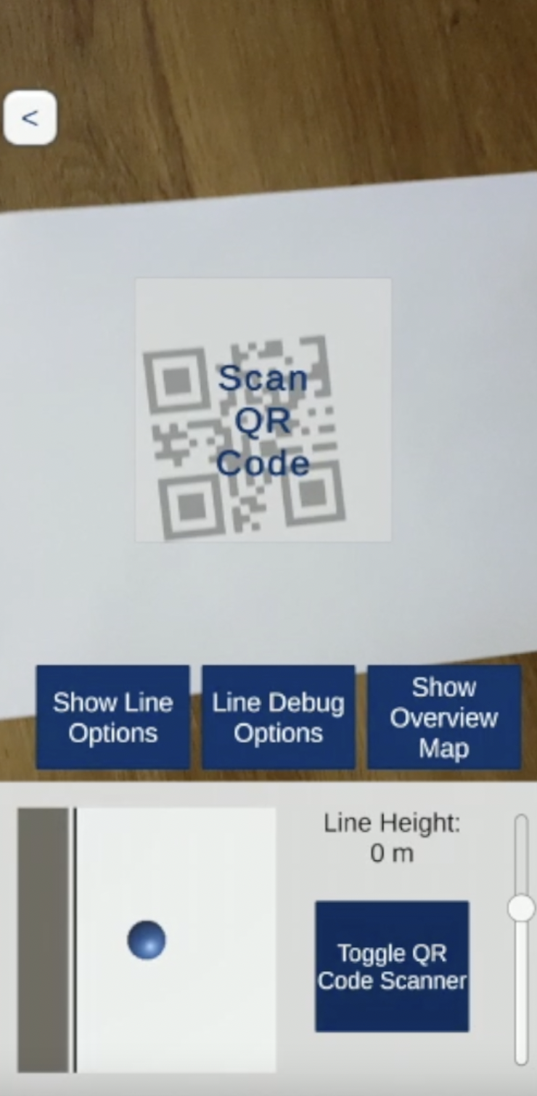
Journey
IoT-Lab AR Application
Implementing QR Scanner
Accessing the Device Camera (Article by Unity)
When the “Scan QR Code“ Panel is activated, the function checks if text is recognized
When QR Code says „Start“ player gets reset to the start position element
→ QR Scanner works
Password protection
Class to handle the password protection
Password saved in variable
By clicking button, input gets compared

Slide 17
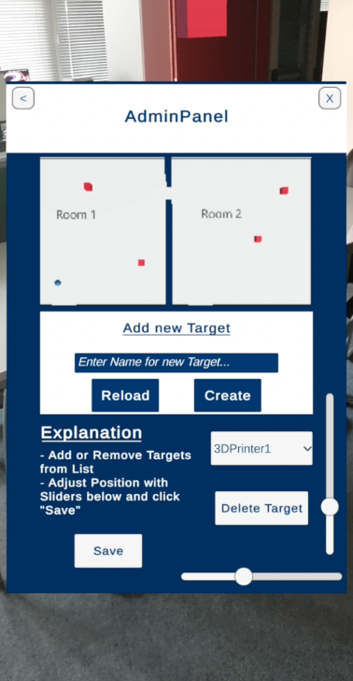
Journey
IoT-Lab AR Application
Admin Panel
Overview Map: New Camera added
Add new Target:
Function for creating new Game object
Adding new item to Target array
Delete Item:
Select target and click button
Delete Game object and target from array
Reload Button: Reload JSON data
Save Button:
JSON with current data gets created
JSON send to server
Two Sliders
Select Item in dropdown menu
Sliders get current position data when item selected
When slider adjusted, item position changes in environment

Slide 18
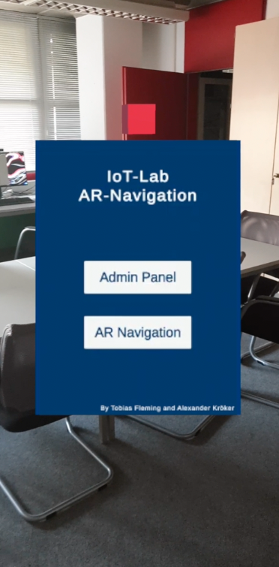
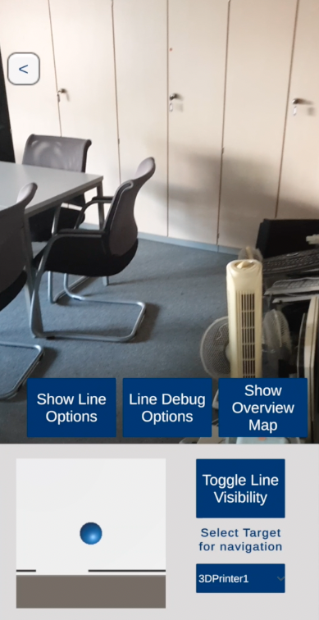
Journey
IoT-Lab AR Application
Designing new Interface

Slide 19

Journey
IoT-Lab AR Application
Web-based JSON file
In order for the user to always have the newest version of target data information
Communicate with REST-Api to send and receive changes
9. Containerized REST-Api with Docker
For testing purposes, the REST-Api was put into a docker container and hosted on Heroku to provide a web service to communicate with

Slide 20

Demonstration
IoT-Lab AR Application

Slide 21
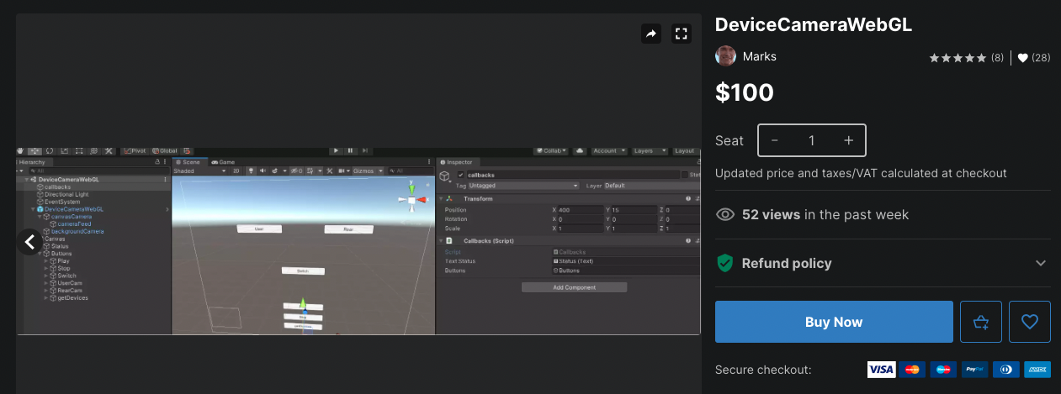
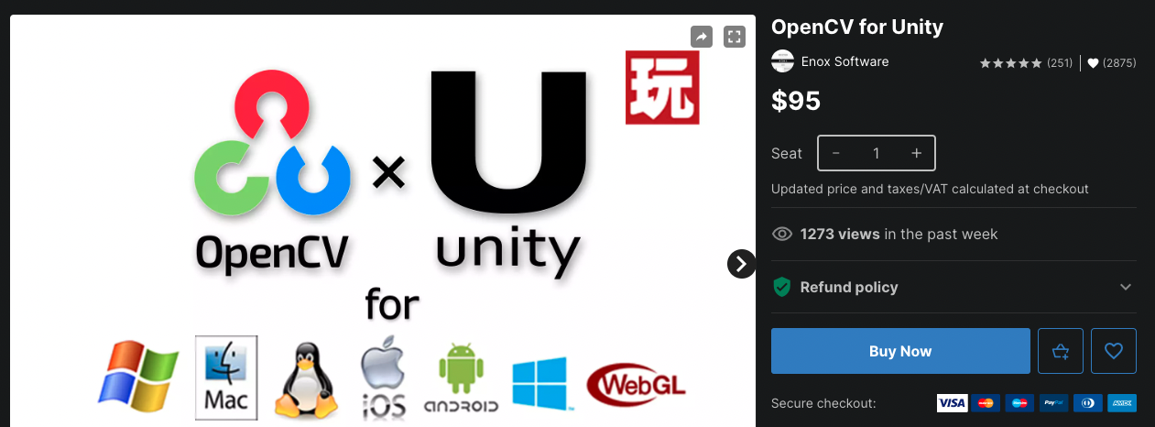
Difficulties during development
IoT-Lab AR Application
Unity documentation hard for beginners
Build In WebGL publishing function
Not possible due to AR Foundation incompatibility
Possible solutions with Unity extensions:
OpenCV for Unity: price 95 dollars
DeviceCameraWebGl: price 100 dollars
ARWT: Only for smaller games, incomplete documentation

Slide 22
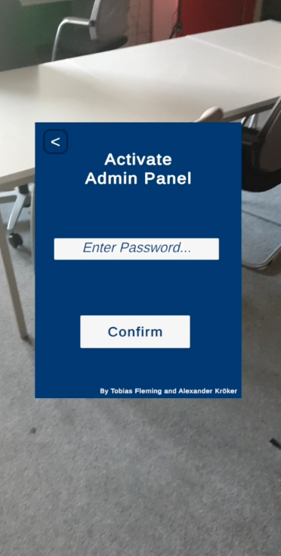
Further development ideas
IoT-Lab AR Application
Improve room recognition
Panel for changing the password
Possibility to scan operating instructions as QR code through the QR scanner to get direct help with questions
Targets get their own icons or avatars
Possibility to change the height of the targets when they are selected or added

Slide 23
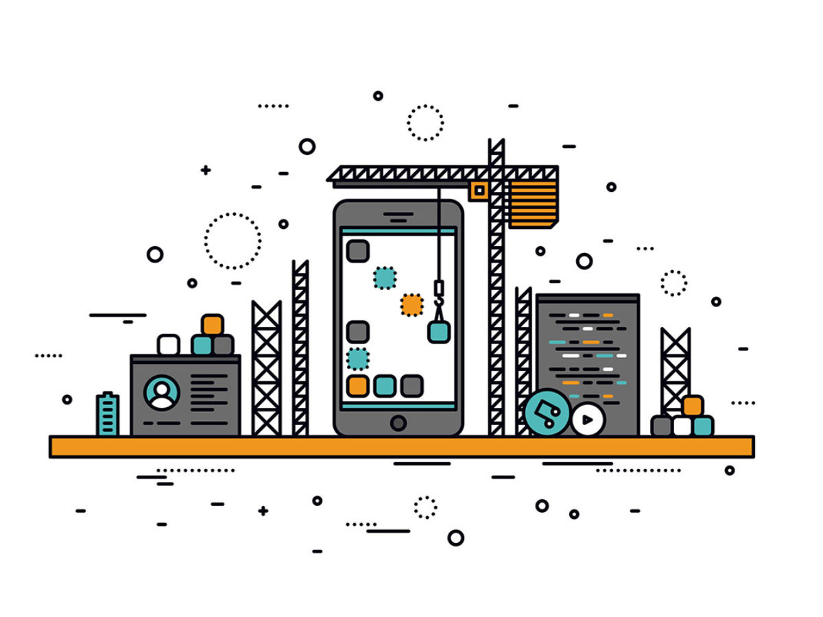
Learnings for our next project
IoT-Lab AR Application
What would we do better next time?
Research is everything
Bug fixing and code documentation takes lots of time
Check all incompatibilities before starting to code
Check all possible ways to create the solution (AR.js vs Unity)
What would we keep?
Weekly Update meetings
4+ hours team coding sessions
Github for code sharing
Shared Discord channels

Slide 24
Sources:
All other pictures taken are from our own Applications. All resources can be found on github:
https://github.com/wintechis/WiSo-OCR-App
https://github.com/wintechis/IoT-Lab-AR-App
Images:
https://play.google.com/store/apps/details?id=com.samsung.Samsung_HA_AR&hl=de&gl=US
https://www.flaticon.com/de/kostenloses-icon/ocr_5200010
https://assetstore.unity.com/packages/templates/packs/ar-foundation-demo-ar-fireworks-139440
https://www.docker.com/company/newsroom/media-resources/
https://buildfire.com/become-mobile-app-developer/

Slide 25
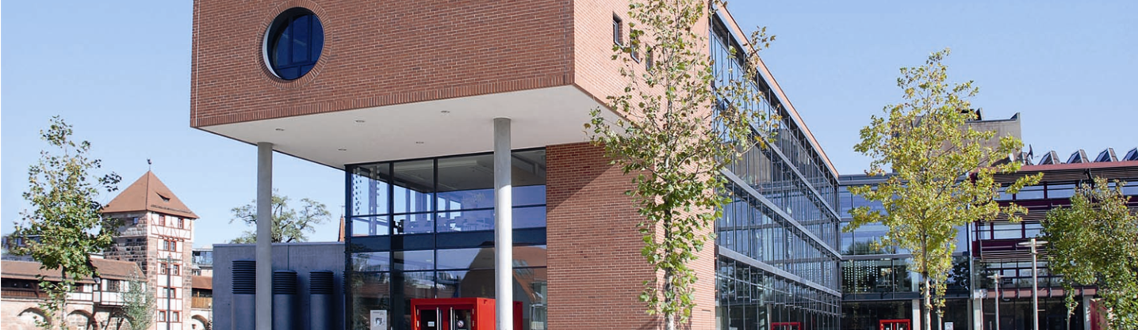
Thank you for your attention!

